Slide 1
Cougars Communications Phase 3 - Presentation
CPT-200 System. Anly. Design-Capstone

Slide 2

Things we have accomplished in this phase
Used .jsx files so that we are able to have cleaner and better functioning coding.
Made the theme of our page a warm and inviting collaboration of SCC colors.
Server is up and running.
Successfully created tables for the backend to store the users data like chats, profile information, and profile pictures.
Cleaned up our code so that it is easier to read and it functions properly.
Made endpoints and API calls so that the backend and frontend can send data back and forth.
Please see examples of all of these changes in the following slides!

Slide 3
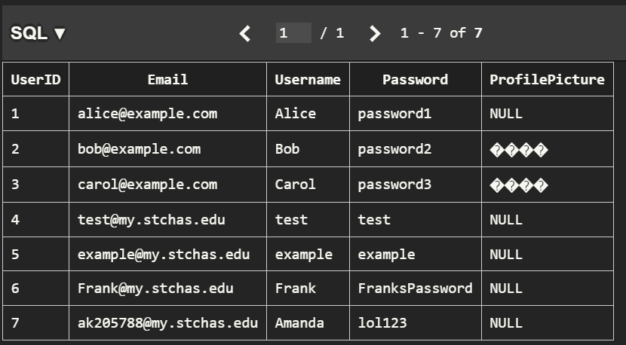
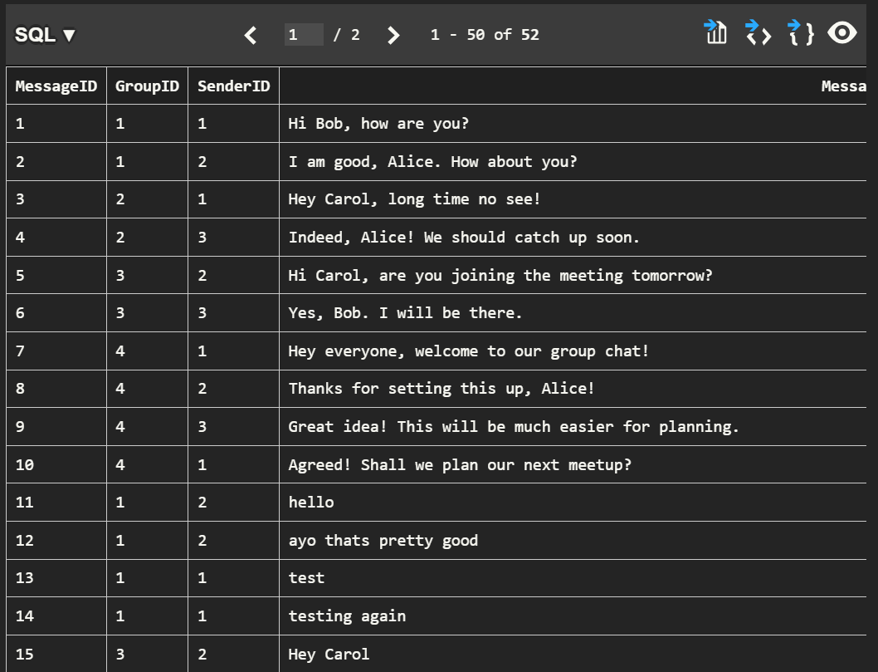
Here you can see the users when signing up are storing to the database and you can also see that when the user is sending messages they are storing in the database correctly .

Slide 4

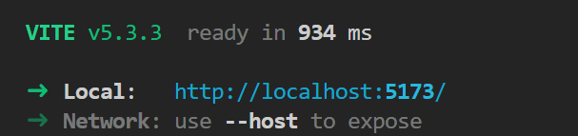
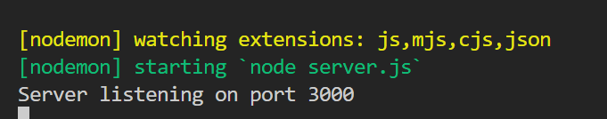
Here you can see that the front end and the back end of our server are working and able to run.

Slide 5
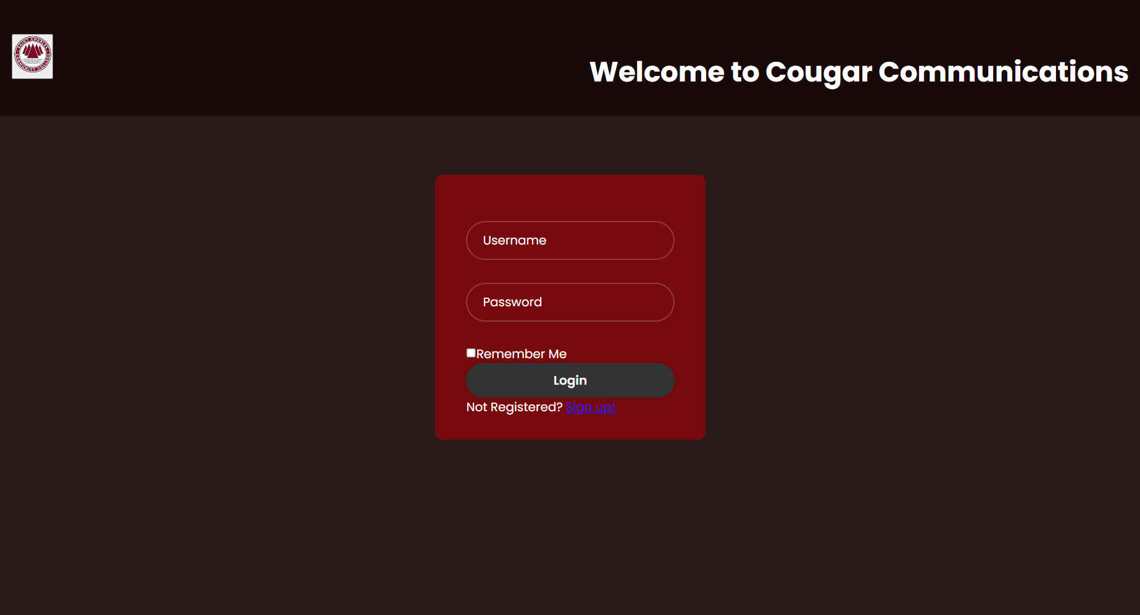
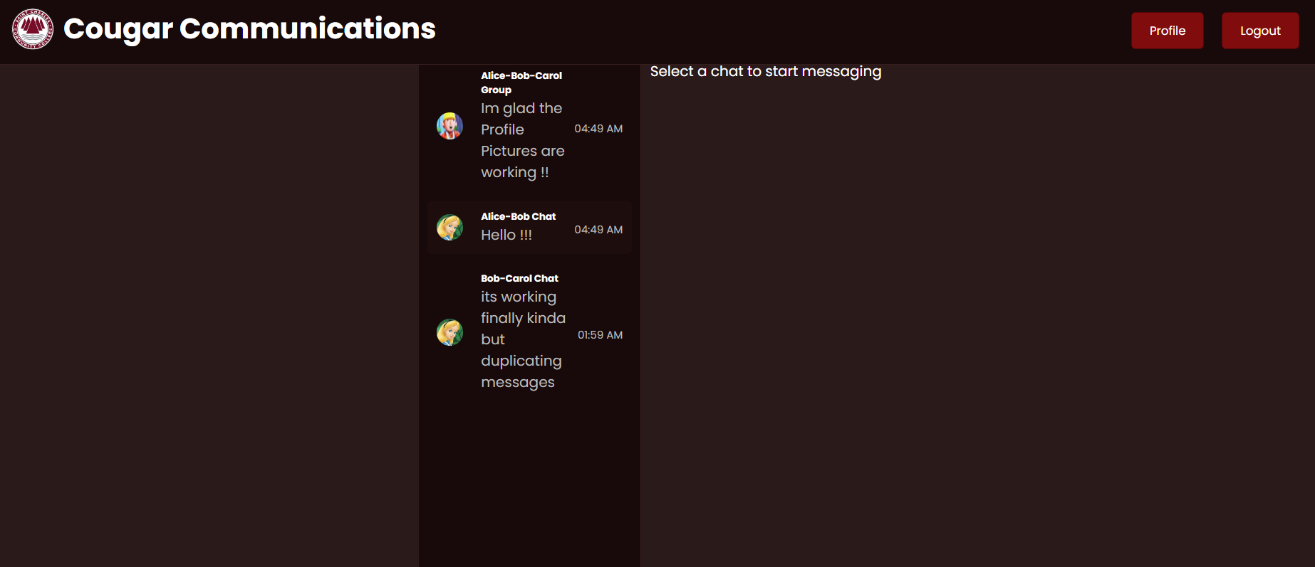
Client Side (Frontend)
Login Page:
Home Page:

Slide 6
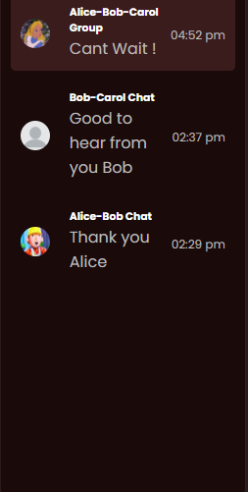
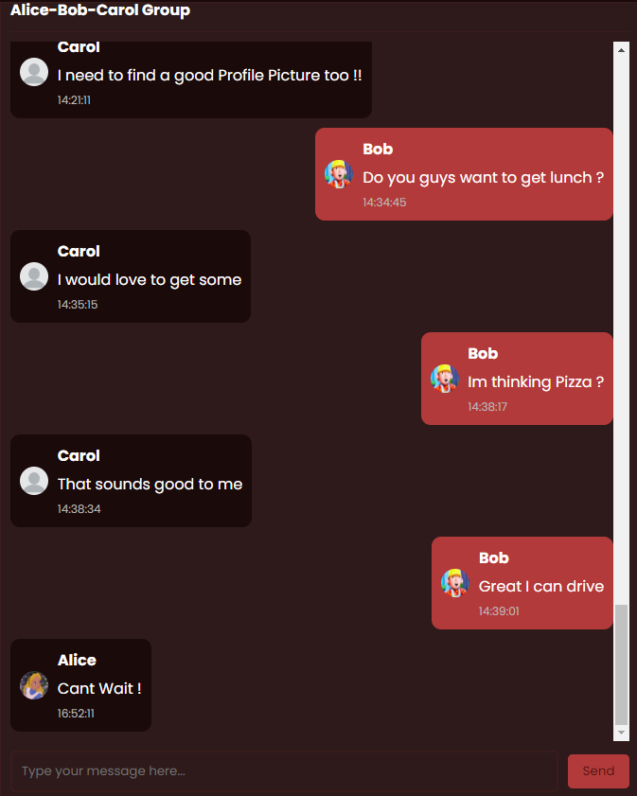
Client Side (Front End)
Chat Interface:
Group Chat Components

Slide 7
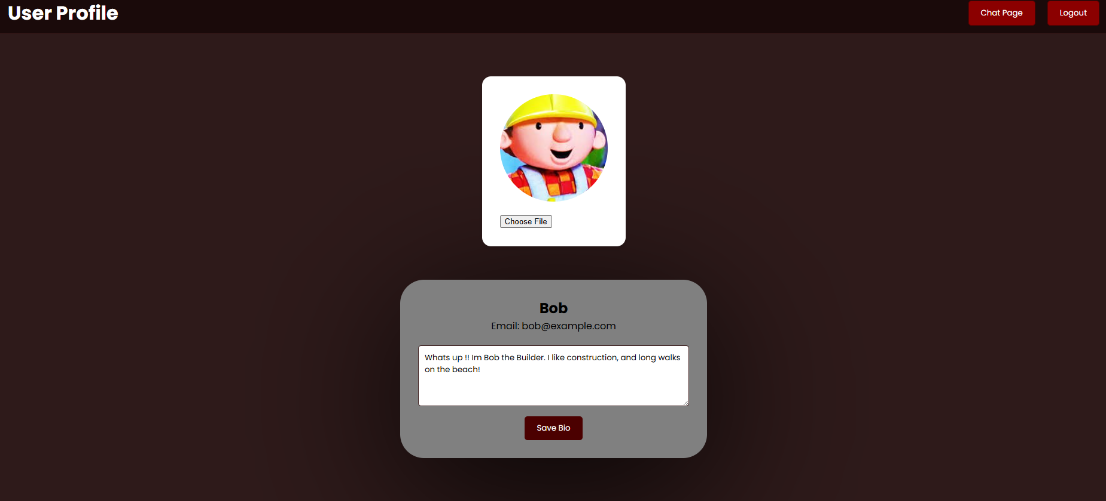
Client Side (Front End)
Chat Interface:
User Profile Page:

Slide 8
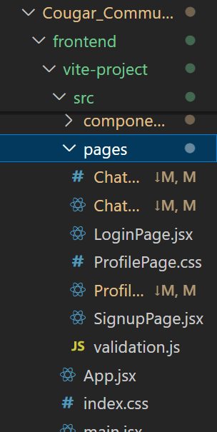
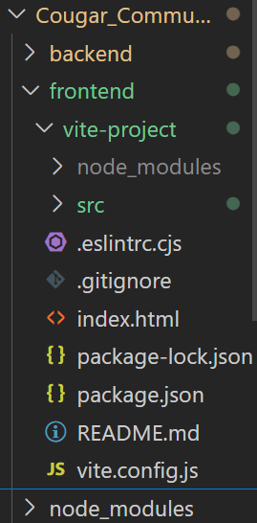
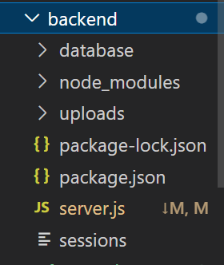
This is the structure of our files in VSC. We have now made sure all of the files are in the correct location and have improved readability and clarity.

Slide 9
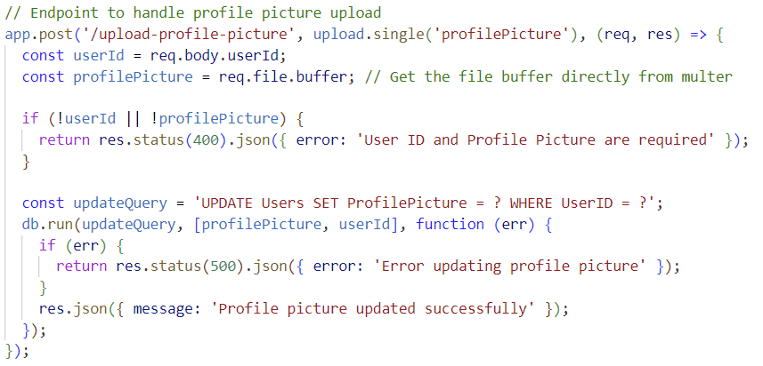
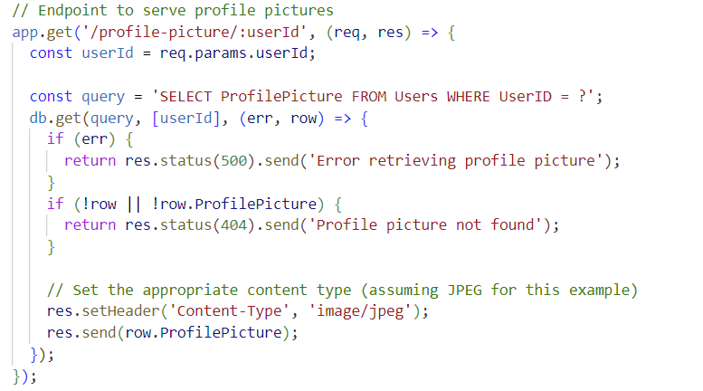
Server Side (Backend)
Profile Picture Feature Backend Implementation:
Technology Used: Express.js and SQLite
File Handling: Multer for file uploads
Database: Storing images as BLOBs in SQLite

Slide 10
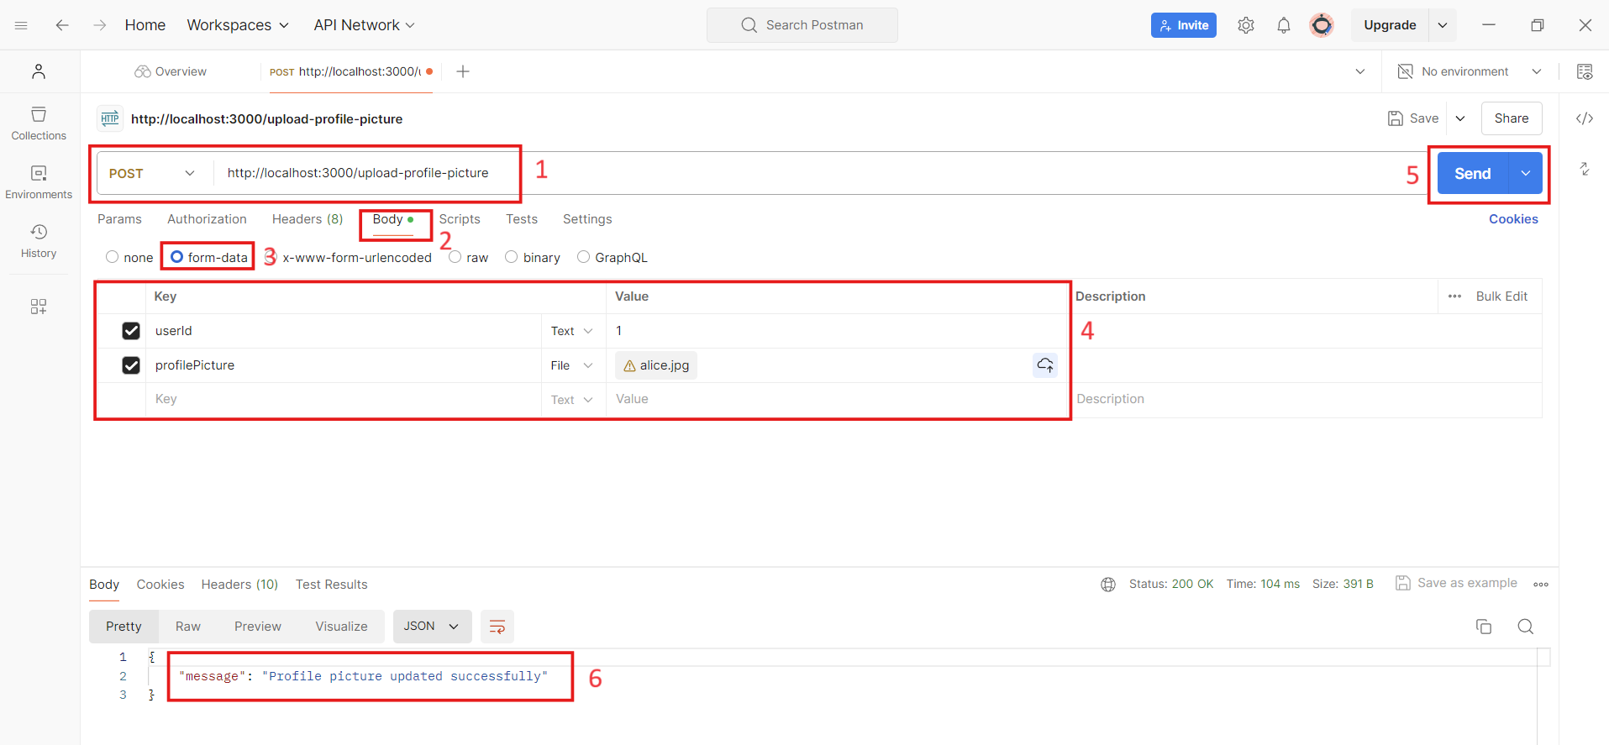
Server Side (Backend)
Using Postman for Testing:

Slide 11
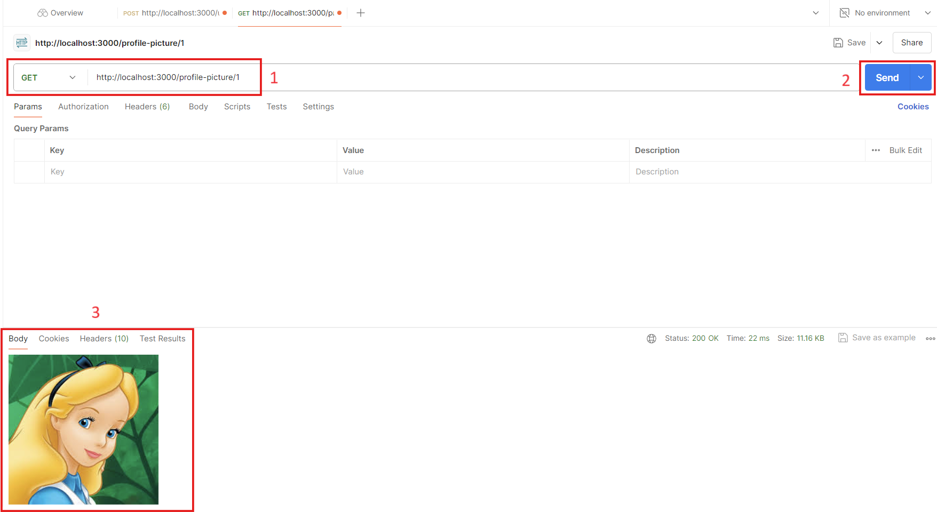
Server Side (Backend)
Using Postman for Testing:

Slide 12
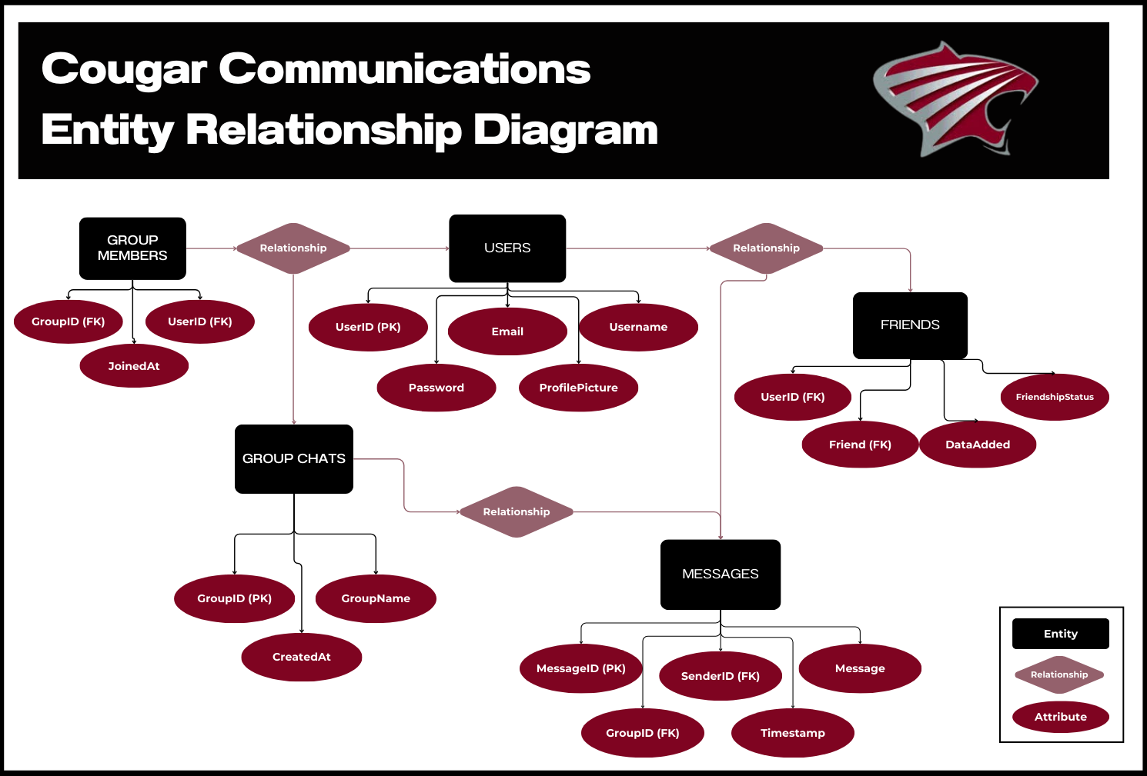
Entity Relationship Diagrams (ERD)

Slide 13
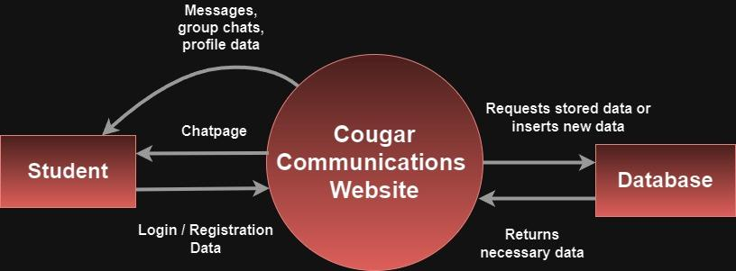
Level 0 Data Flow Diagram (DFD)

Slide 14
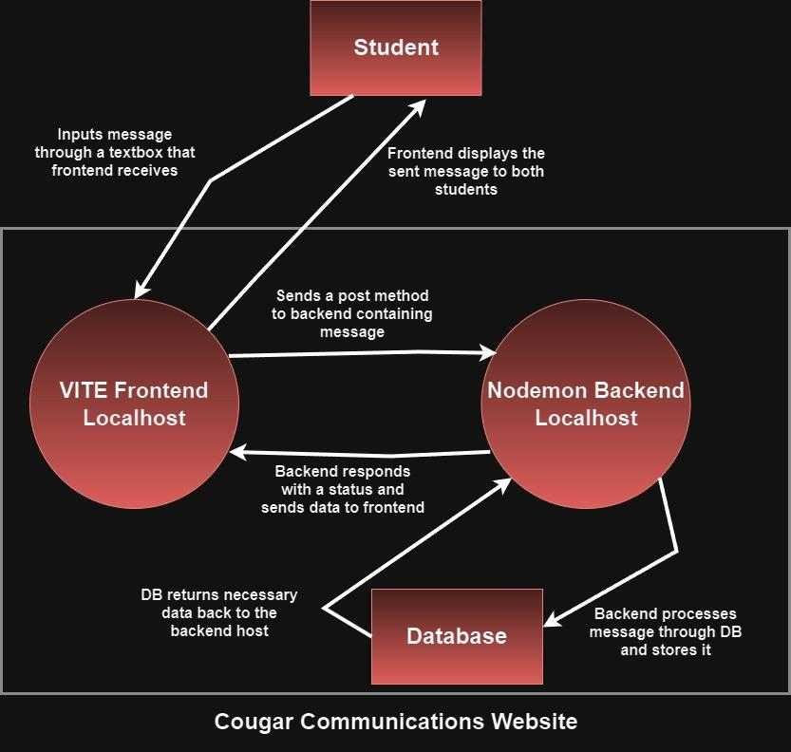
Level 1 Data Flow Diagram (DFD)

Slide 15

Progress we plan to make in the future !
Goals
Add friends to chat with and creating new chats
Make profile picture links to users profile page
Continue testing of group chatting functions
Implementing the AI into the top of the friends bar
Fine tuning CSS for best UI experience
Chat messages should instant push the page to the bottom of the screen
Deadlines
EOD 07/17/24
EOD 07/18/24
Continue until project due date
EOD 07/21/24
EOD night before project due
EOD 07/20/24

